Slide 1
FALL DETECTION SYSTEM USING NODEMCU & MPU6050 SENSOR
Swathi S [210701274]
Tamanna [210701281]
Tejashree D [210701287]

Slide 2
Table of Contents
1. Abstract
2. Introduction
3. Objectives
4. Literature survey
5. Existing System
6. Proposed Solution
7. Modules
8. System Architecture
9. Conclusion
10. Future Enhancements
11. Reference

Slide 3
Abstract
Senior citizens has many problems and complications in their later stage of life. Their common problems include dizziness, memory impairment and imbalanced walking, increasing their susceptibility to falls, especially when they are alone. Most worrying concern about them especially when they are alone is falling down. This project focuses on leveraging IOT address the issue of falling down. By integrating location tracking and anomaly detection, the caregivers can receive alerts when the anomalies are detected from their usual movement of body. This approach enables caregivers to promptly respond to potential fall risks and provide assistance as needed, significantly reducing the likelihood of serious injuries.

Slide 4
Introduction
Falls among senior citizens present a significant public health concern, often resulting in serious injuries and reduced quality of life. As the global population continues to age, there is a growing need for innovative solutions to mitigate fall risks and enhance the safety of older adults, particularly when they are living independently. This project proposes the integration of IoT technology to address this challenge, providing caregivers with real-time monitoring and intervention capabilities to prevent falls and minimize associated injuries.

Slide 5
Objectives
To develop a robust IoT-based system capable of accurately detecting and alerting caregivers to potential fall events among senior citizens.
To implement continuous learning mechanisms within the system to enhance its effectiveness over time.
To create a comprehensive solution that not only identifies immediate fall risks but also learns from past incidents to better predict and prevent future falls.
To provide caregivers with a reliable tool to monitor and protect the elderly, ultimately improving their quality of life and promoting independence.
To Improve Quality of Life for senior citizens by reducing the occurrence and severity of fall-related injuries and promoting independence through effective fall prevention measures.

Slide 6
Literature Survey
1. The research paper published in 2018 [1] introduced an IoT-based fall detection system that utilizes big data analytics for real-time monitoring and analysis of movement patterns, showcasing the potential of IoT technology in enhancing fall detection accuracy
2. Another paper published in 2016 [2] focused on the development of a wearable fall detection system, emphasizing the importance of portability and user convenience, thereby addressing the need for unobtrusive monitoring solutions for elderly individuals.
3. A paper published in 2016 [3] emphasized the significance of user-centered design principles in the development of fall detection systems tailored specifically for older adults.
4. Additionally, a paper published in 2019 [4] extended their research by incorporating ensemble machine learning algorithms into their fall detection system, demonstrating notable improvements in detection accuracy and reliability.

Slide 7
Existing System
Current Fall Detection Systems:
Wearable Devices: Smartwatches and pendants with sensors.
Movement Monitoring: Accelerometers and gyroscopes track movements.
Challenges with Wearables:
Dexterity Issues: Difficult for seniors with limited hand function.
Cognitive Impairments: Confusing for those with memory problems.
Non-Compliance Risk: Potential for not wearing the device.
Misplacement Concerns: Effectiveness lost if the device isn’t worn.

Slide 8
Proposed Solution
Data Acquisition:
Read acceleration (ax, ay, az) and gyroscope (gx, gy, gz) data from MPU6050.
Threshold Triggers:
Trigger 1: AM breaks lower threshold (0.4g).
Trigger 2: AM breaks upper threshold (3g).
Trigger 3: Orientation change (80-100 degrees).
Fall Detection:
Detect fall based on triggers.
Send event to IFTTT (e.g., notify caregivers).

Slide 9
Future Enhancements
• Sensor Integration: Integration of additional sensors or wearable devices to enhance the system's capabilities for monitoring various health parameters beyond fall detection, such as heart rate, blood pressure, or oxygen levels.
• Machine Learning Algorithms: Investigating the use of machine learning algorithms to analyze collected data and improve the system's ability to predict fall risks based on individual behavior patterns and health trends.
• Integration with Healthcare Systems: Exploring opportunities for integrating the fall detection system with existing healthcare systems and electronic health records (EHRs).

Slide 10
Modules
1. NodeMCU ESP8266 12E Board
2. MPU6050 6-axis Gyroscope/Accelerometer
3. Breadboard
4. Solderless Breadboard Mini
5. Jumper Wires
6. Arduino IDE
7. Blynk Library for NodeMCU

Slide 11
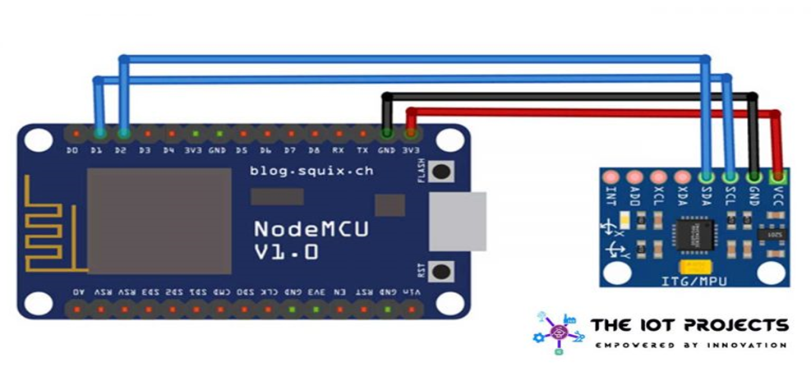
System Architecture

Slide 12
Conclusion
Innovative IoT Solution: Integration of NodeMCU, MPU6050, and IFTTT for real-time fall detection.
Enhanced Safety: Immediate alerts to caregivers, improving elderly care.
Smart Monitoring: Location tracking and anomaly detection for proactive risk management.
Adaptive Learning: Evolves to predict and prevent falls, ensuring long-term effectiveness.
Empowering Seniors: Supports independence while reducing caregiver stress.

Slide 13
References
[1] Wang, Xueyi, Joshua Ellul, and George Azzopardi. "Elderly fall detection systems: A literature survey." Frontiers in Robotics and AI 7 (2020): 71.
[2] Igual, Raul, Carlos Medrano, and Inmaculada Plaza. "Challenges, issues and trends in fall detection systems." Biomedical engineering online 12.1 (2013): 66.
[3] Jain, Nirbhay, et al. "Fall Detection System Using Machine Learning Approach." Interdisciplinary Research in Technology and Management. CRC Press 498-503.AP
[4]Soni, Vaibhav, Guruwesh Yadav, and Vijay Bhaskar Semwal. "Elderly Fall Detection Using Attention Based dilated CNN and dilated BiLSTM." 2024 International Conference on Automation and Computation (AUTOCOM). IEEE, 2024.

